Slide 1
GWAS and Mendelian Randomization
Applying modern-day genomic knowledge within the atherosclerotic field

Slide 2
What we’ll discuss today…
Any remaining questions
Recap what we learned
Personal genomics
Drug development
Biomarker validation

Slide 3
Modern-day Genomics
Recapturing what learned

Slide 4
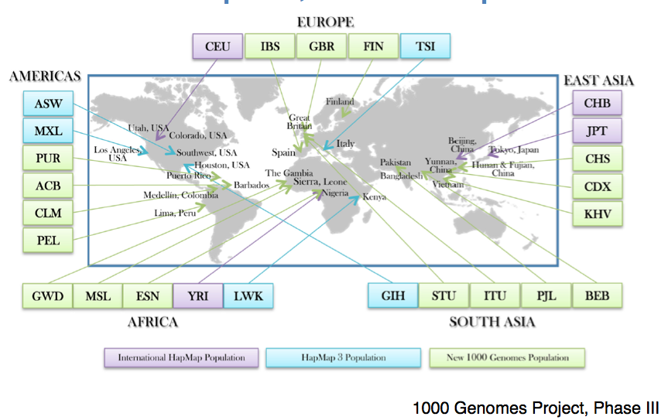
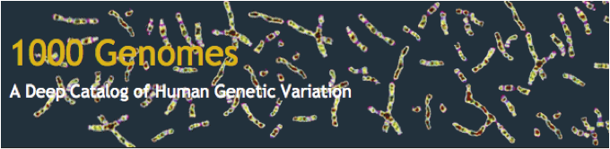
Millions of variants in many populations

Slide 5
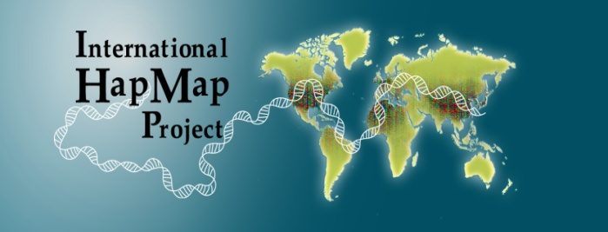
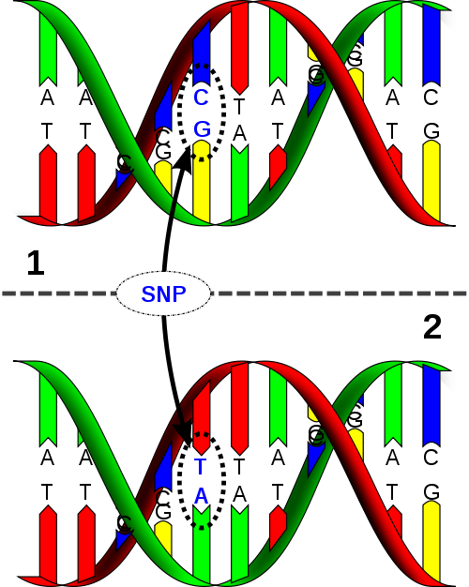
Single-Nucleotide Polymorphism
“one base pair variation”
> 1% general population (common)
≈10 million SNPs (≈0.25% genome)
Makes you and me unique
Most common type of genetic variation
Can alter amino acid sequence
Differential correlation between SNPs in various populations
Used as proxies in genetic associations studies
www.hapmap.org
Maternal copy
Paternal copy

Slide 6
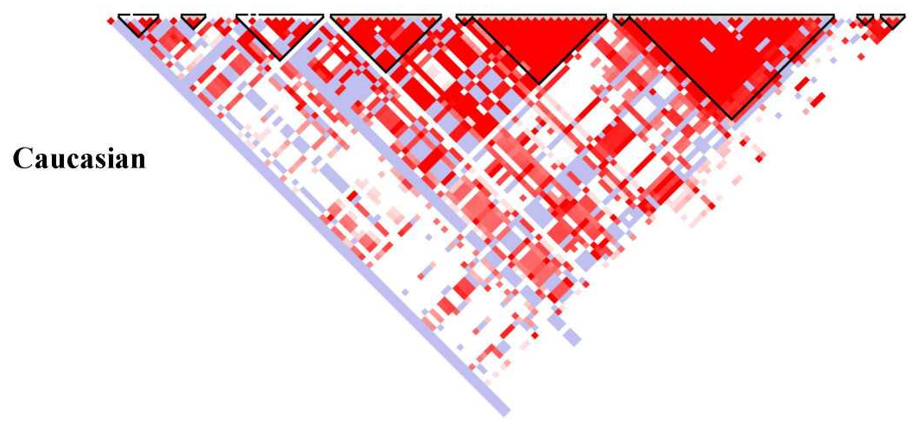
Linkage disequilibrium
Non-random association of alleles at two or more loci
causal variant
genotyped marker
r²
Because of linkage disequilibrium between SNPs
Genetic association studies can investigate genotyped markers (SNPs)
And use these as proxies of the causal variant
G
G
allele frequency
T
T
cases
controls

Slide 7
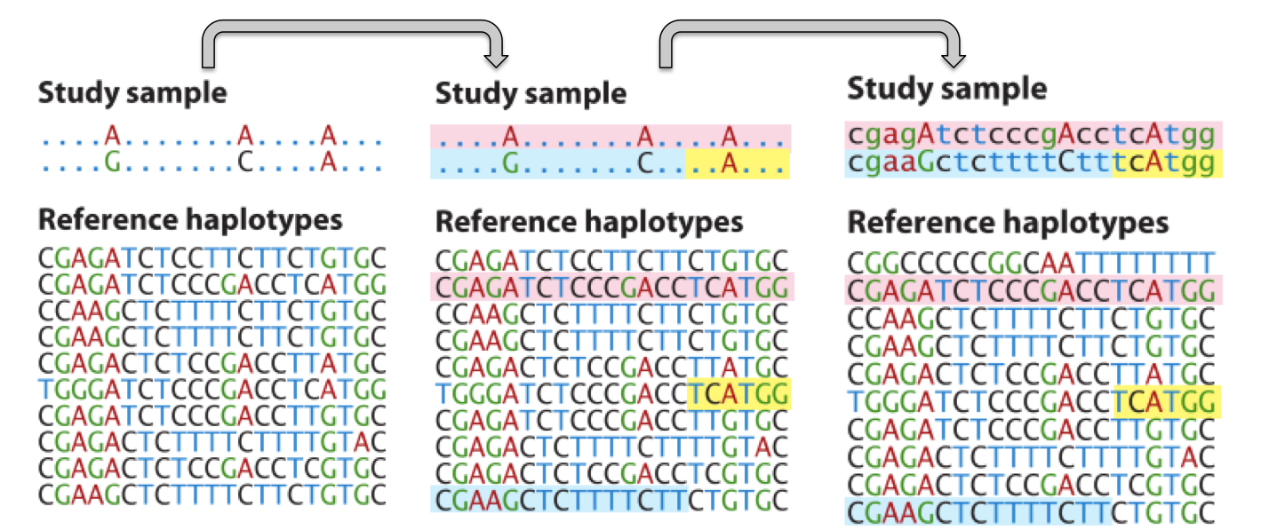
Imputation
Imputation: infer untyped genotypes based on a suitable reference panel of well-characterized and validated genotypes

Slide 8
Manolio, T.A., et al. Nature; 461:747-753; 2009
Mendelian and
monogenic disease
Very rare variants
Complete penetrance
Common disease
Effect size
Rare and low-frequency variants
Large effect size
Common disease
Common variants Smaller effect sizes
Variant frequency
Rare (< 0.5%)
Low-frequency (0.5-5%)
Common (>5%)

Slide 10
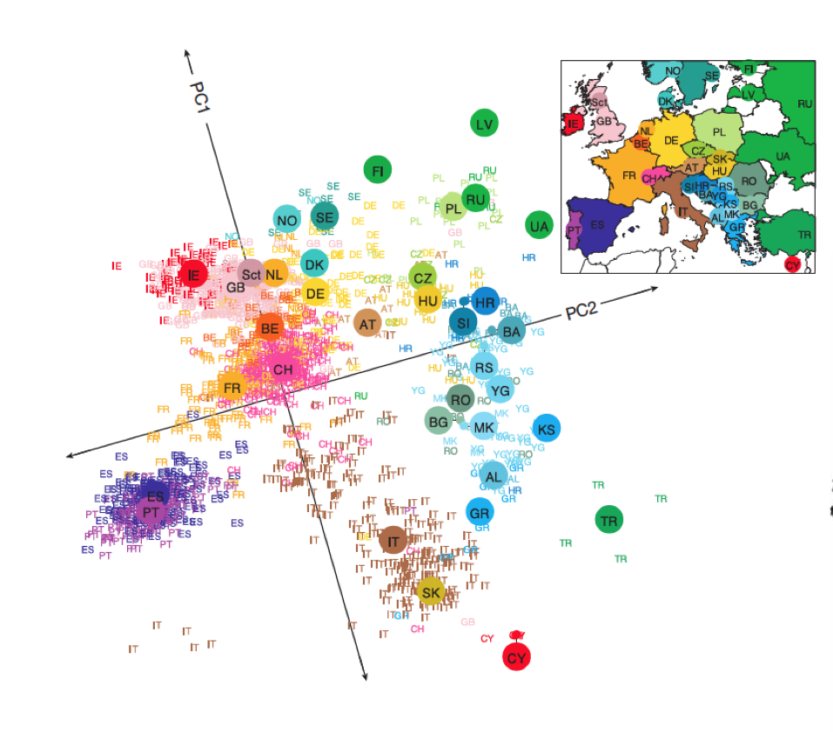
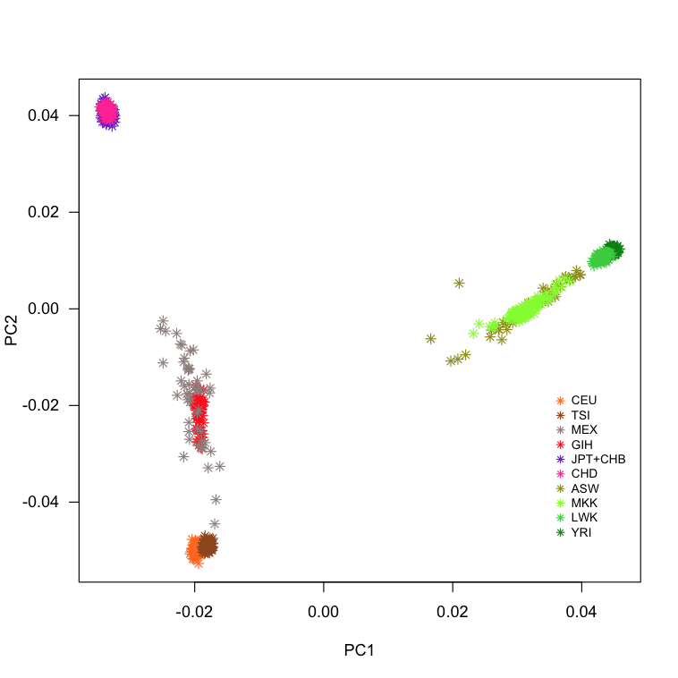

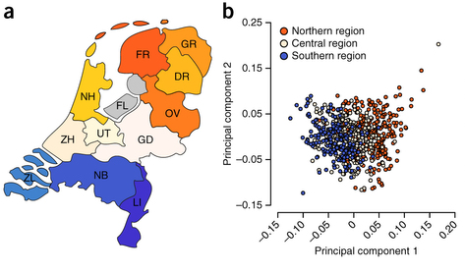
Population stratification
East Asian ancestry
African ancestry
Admixed
samples
European ancestry

Slide 11
Power, Effect size, Sample size…
Pulit, S., et al. Genes & Genomes; 2014

Slide 12
Personal Genomics
Clinically applying genomics

Slide 13
9p21 was used in a laboratory DNA test
deCODE Genetics’ deCODE MI™
Assessment of the risk for (early–onset) myocardial infarction
SNPs rs133049 and rs10757278 located in vicinity to CDKN2A and CDKN2B
Risk allele is independent and additive to traditional risk factors (Framingham Heart Score, Reynold’s score, AIRIC score)
20-22% of the general population carry the risk allele
≥40% in patients suffering early MI (male < 50 years, female < 60 years)
Carrying two copies of the risk allele correspond to an approximate 1.6 fold increase over the general population of early onset MI and a 1.3 fold risk of MI in general
Tested according to CLIA, but not FDA approved
Collaboration with clinicians/clinical geneticists

Slide 14
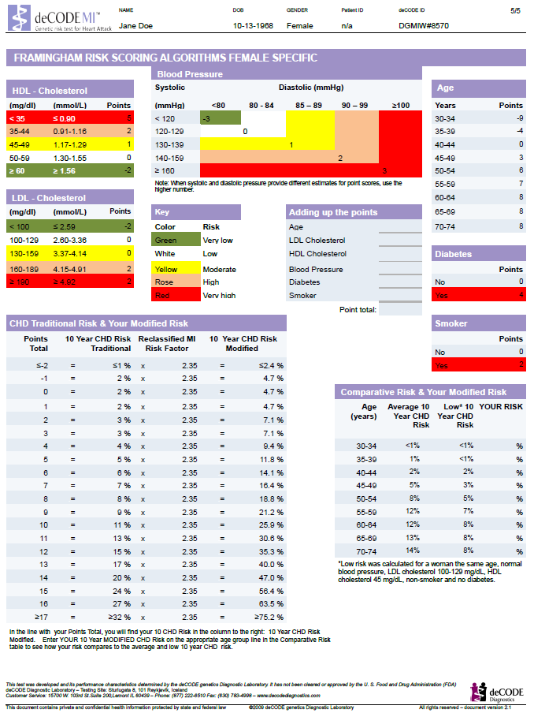
deCODE MI™ provided a modified 10 year CHD risk
Cut-off, at which point some form of (drug) therapy starts

Slide 15
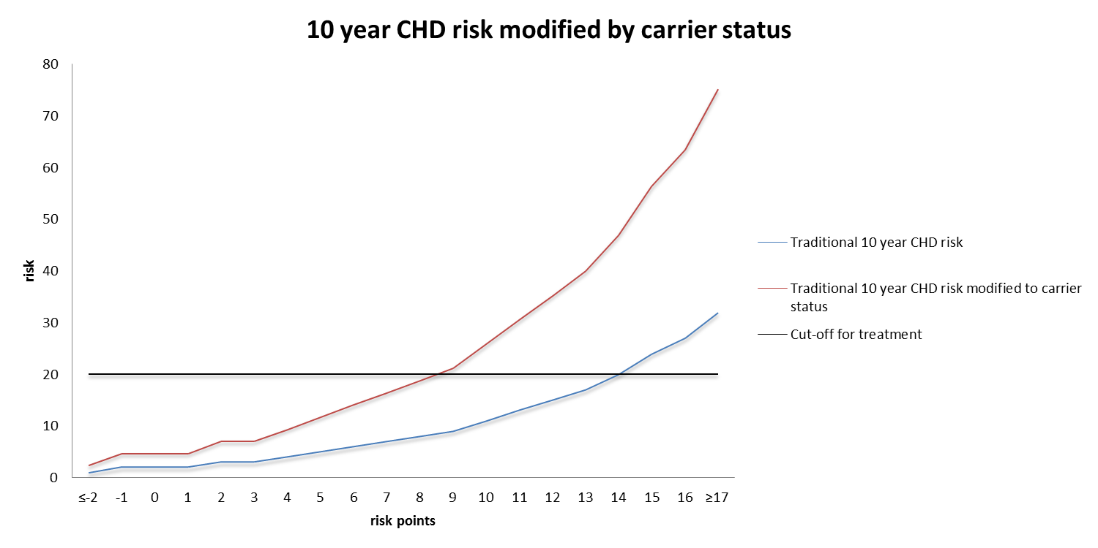
From 9 to more than 20% risk

Slide 16

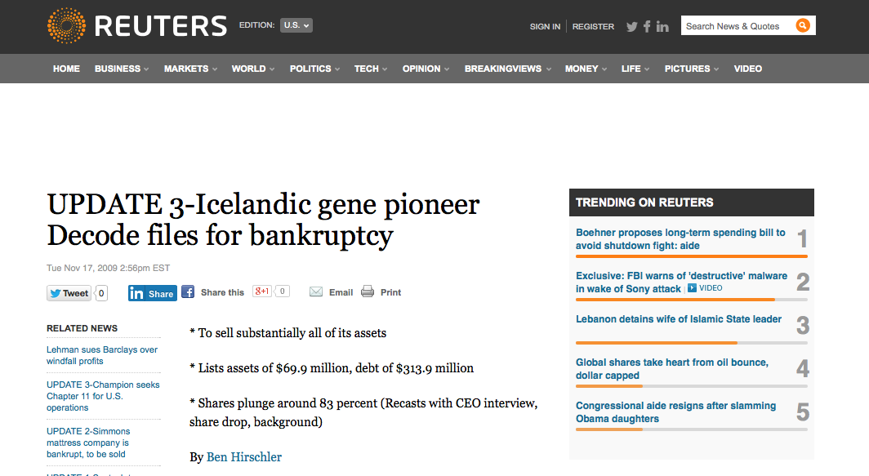
So what happened to deCODE Genetics?

Slide 17
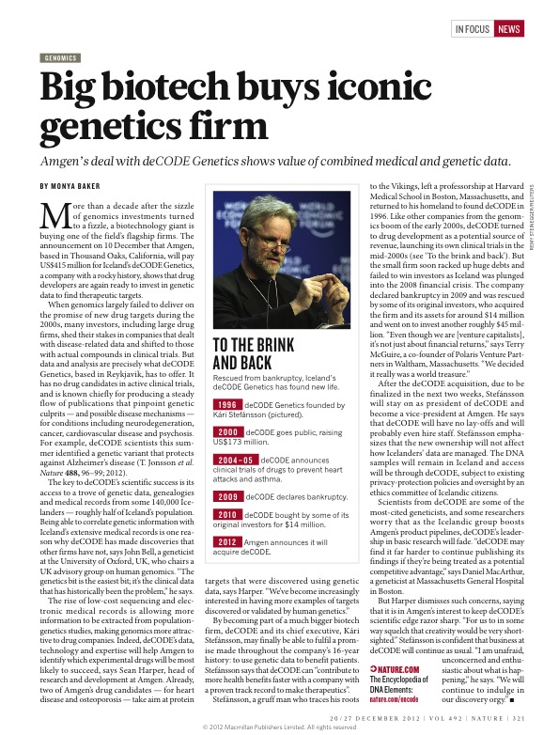


AMGEN revenue $18.8 billion
12th in the world after Pfizer ($40b), GSK ($33.3b) and Lilly ($20.9b)

Slide 18

What is 23andMe?
Google “owned”
Google founders invested in excess of $3.9 million
23andMe raised in excess of $50 million
Personal genomics
Genetic information based on personal genotyping and current literature knowledge
Individual prediction of risk similar to deCODEme
Not FDA approved – forbidden to sell pending approval

Slide 19
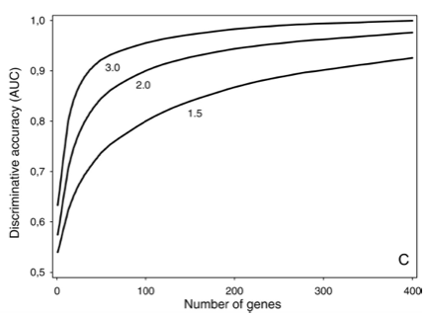
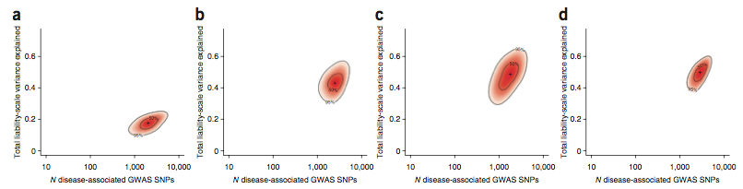
The added value of Polygenic Burden/Risk Scores?
Polygenic Burden/Risk Scores in addition to existing risk factor models
Hundreds of variants are needed for any meaningful addition
Upside: many variants remain to be discovered explaining more of the biology of phenotypes

Slide 20
New drugs
Clinically applying genomics

Slide 21
Proprotein convertase subtilisin/kexin type 9
Variants in PCSK9 associated with low LDL and lower risk for CHD
Cure?

Slide 22
Clinical trials for PCSK9 antibodies

Slide 23
Clinical trials for PCSK9 antibodies

Slide 24
The human “knockout” is probably the best model

Slide 25
Validating biomarkers
Clinically applying genomics

Slide 26
Cystatin C
Encoded by CST3 on 20p11.21
Protease inhibitor
Activity of cathepsins (cysteine proteases) in vascular smooth muscle cells
Prevention of plaque formation by binding amyloid-beta precursor protein (APP) in Alzheimer’s disease
Shi et al. JCI 1999; Kaeser et al. Nat Genet 2007; Mi et al. Nat Genet 2007

Slide 27
A role in atherosclerotic disease
Reduction of Cystatin C in abdominal aortic aneurysm (in smooth muscle cells)
Lack of Cystatin C in mice promotes atherosclerosis
Shi et al. JCI 1999; Bengtsson et al. ATVB 2005

Slide 28
Epidemiological evidence
In elderly without chronic kidney disease (CKD), Cystatin C (CystC) is prognostic of death, cardiovascular disease (CVD) and CKD
Asymptomatic carotid atherosclerosis patients, CystC prognostic for CVD
CystC associated with lesion size in acute stroke

Slide 29
Literature meta-analyzed
Cystatin C is associated with a higher risk of CVD, stroke and mortality in high-risk populations
With heart failure, CHD, >70 years…
Lee et al. JCI 1999; Bengtsson et al. Circ CQO 2010

Slide 30
Chronic Kidney Disease

Slide 31
Cystatin C as a biomarker for CKD
One of the best naturally occurring biomarker for human estimated glomerular filtration rate
It is a better biomarker than creatinine when eGFR>90 (mL/min/1.73m³)
Fried et al. Kid Intern 2009; Inker et al. NEJM 2012
Notes:
Chronic kidney disease epidemiology collaboration formula/equation

Slide 32
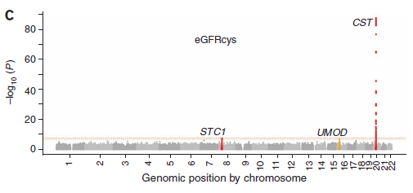
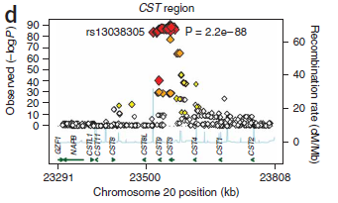
GWAS: locus with CST3 pops up (naturally)
Three Genome–Wide Association Study Meta-Analyses of eGFR and CKD revealed a region containing CST3 (Cystatin C) as significantly associated
Identification of three loci associated with eGFRcys aka cystatin C expression: STC1, UMOD, CST3
Köttgen et al. Nat Genet 2009
May 11, 2015 | 32

Slide 33
Athero-Express

Slide 34
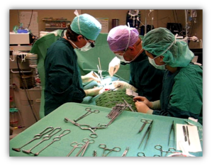
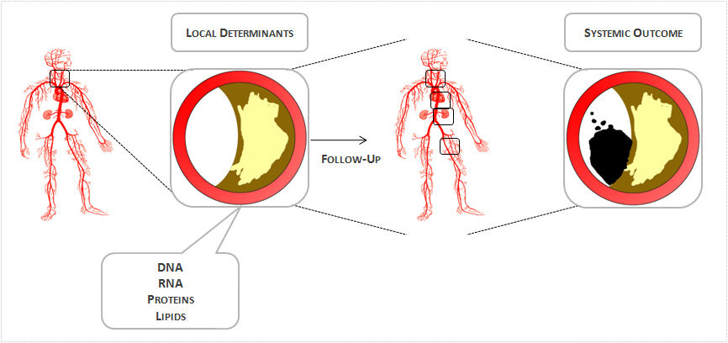
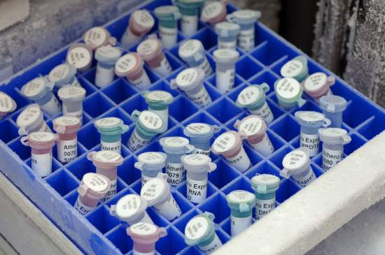
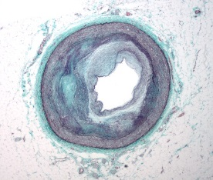
This was the start of our work...
Is there an association of CystC associated variant with CystC and smooth muscle cells in the carotid plaque?

Slide 35
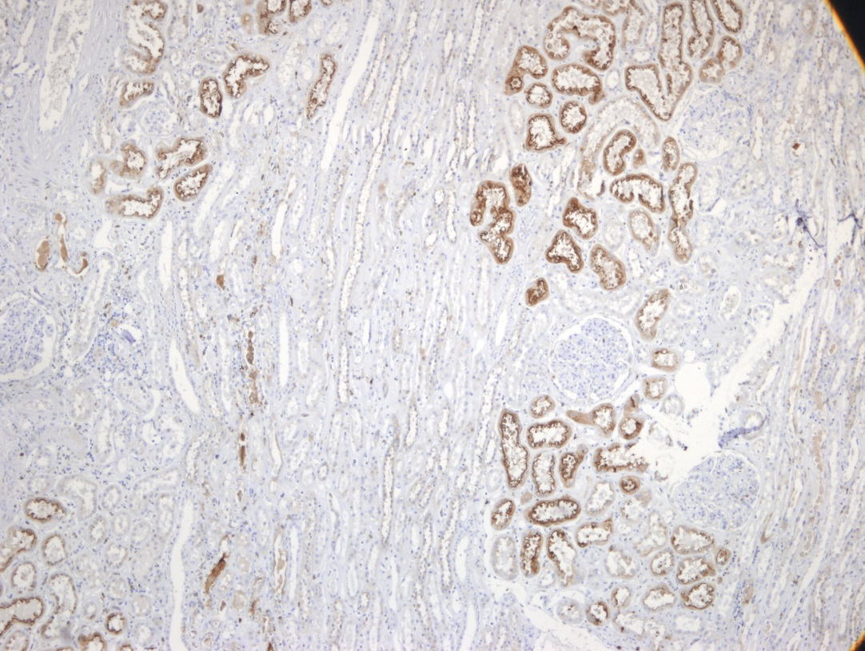
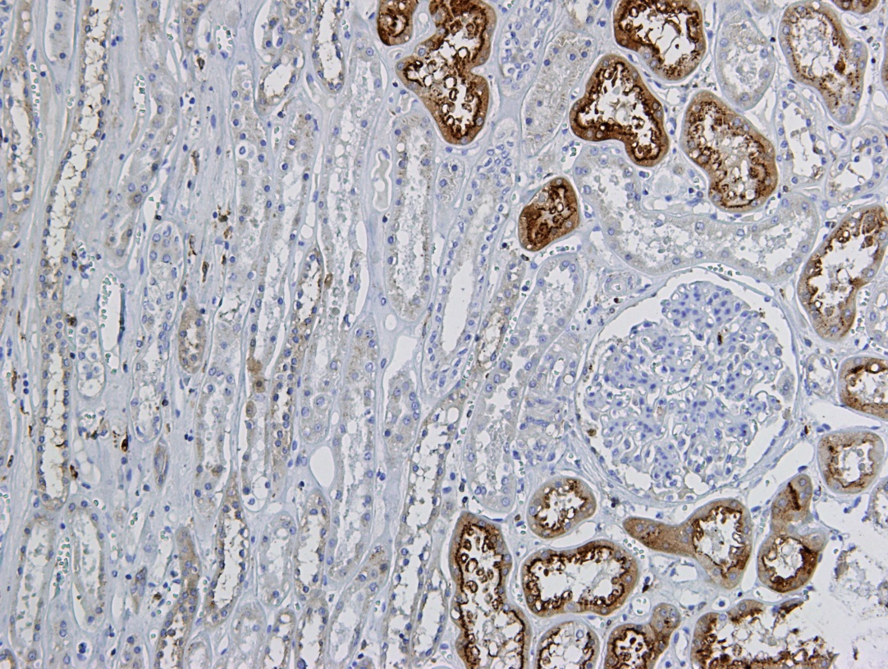
Histological staining for CystC
First a positive control: the human kidney
CystC present in proximal (?) tubuli
Appears to be present in granules
Van der Laan et al. unpublished

Slide 36
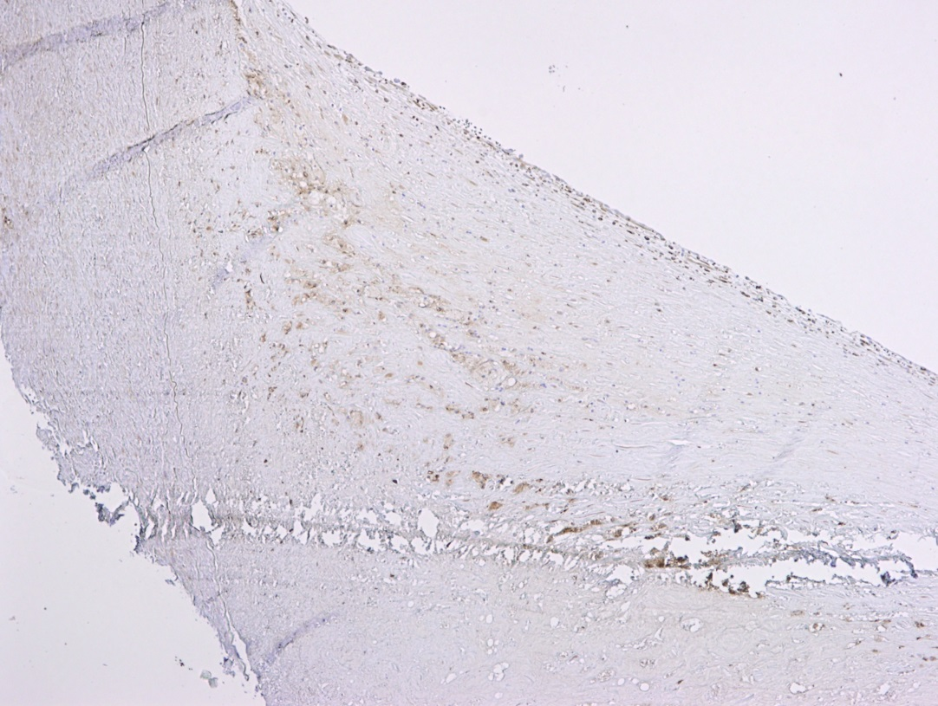
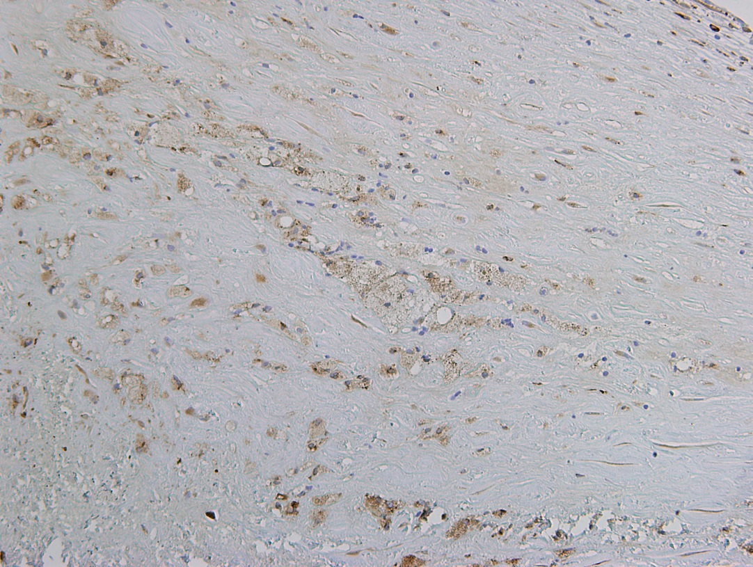
Carotid endarterectomy sample
Shoulder region, clear staining for CystC
Appears to be stronger in foamy cells, (foamy) smooth muscle cells
Also a-specific (?) coloring of fat
Limitation: no double-staining for α-actin
Van der Laan et al. unpublished

Slide 37
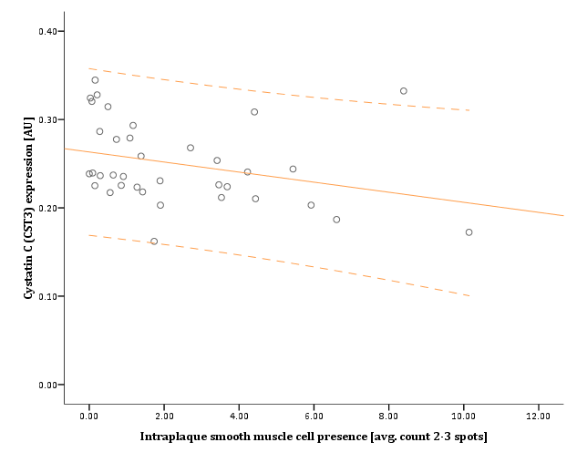
Quantitative Proteomics substantiates Genomic Analyses
40 Athero-Express patients selected for individual quantitative plaque proteomics
Cystatin C protein expression negatively correlated with smooth muscle cells
Rho=-0.415, P=0.012
Literature: Cystatin C is expressed by SMCs, and markedly decreased in atherosclerotic tissue
Validation of these results in the remaining Athero-Express CEA cohort:
N=1,711 patients
Males: 1,174 / Females: 537
Average age: 68.03 [years]
Males: 67.90 / Females: 68.33
Average eGFR: 70.77 [mL/min/1.73m²]
Males: 71.95 / Females: 68.04
Shi et al. JCI 1999; Van der Laan et al. unpublished

Slide 38
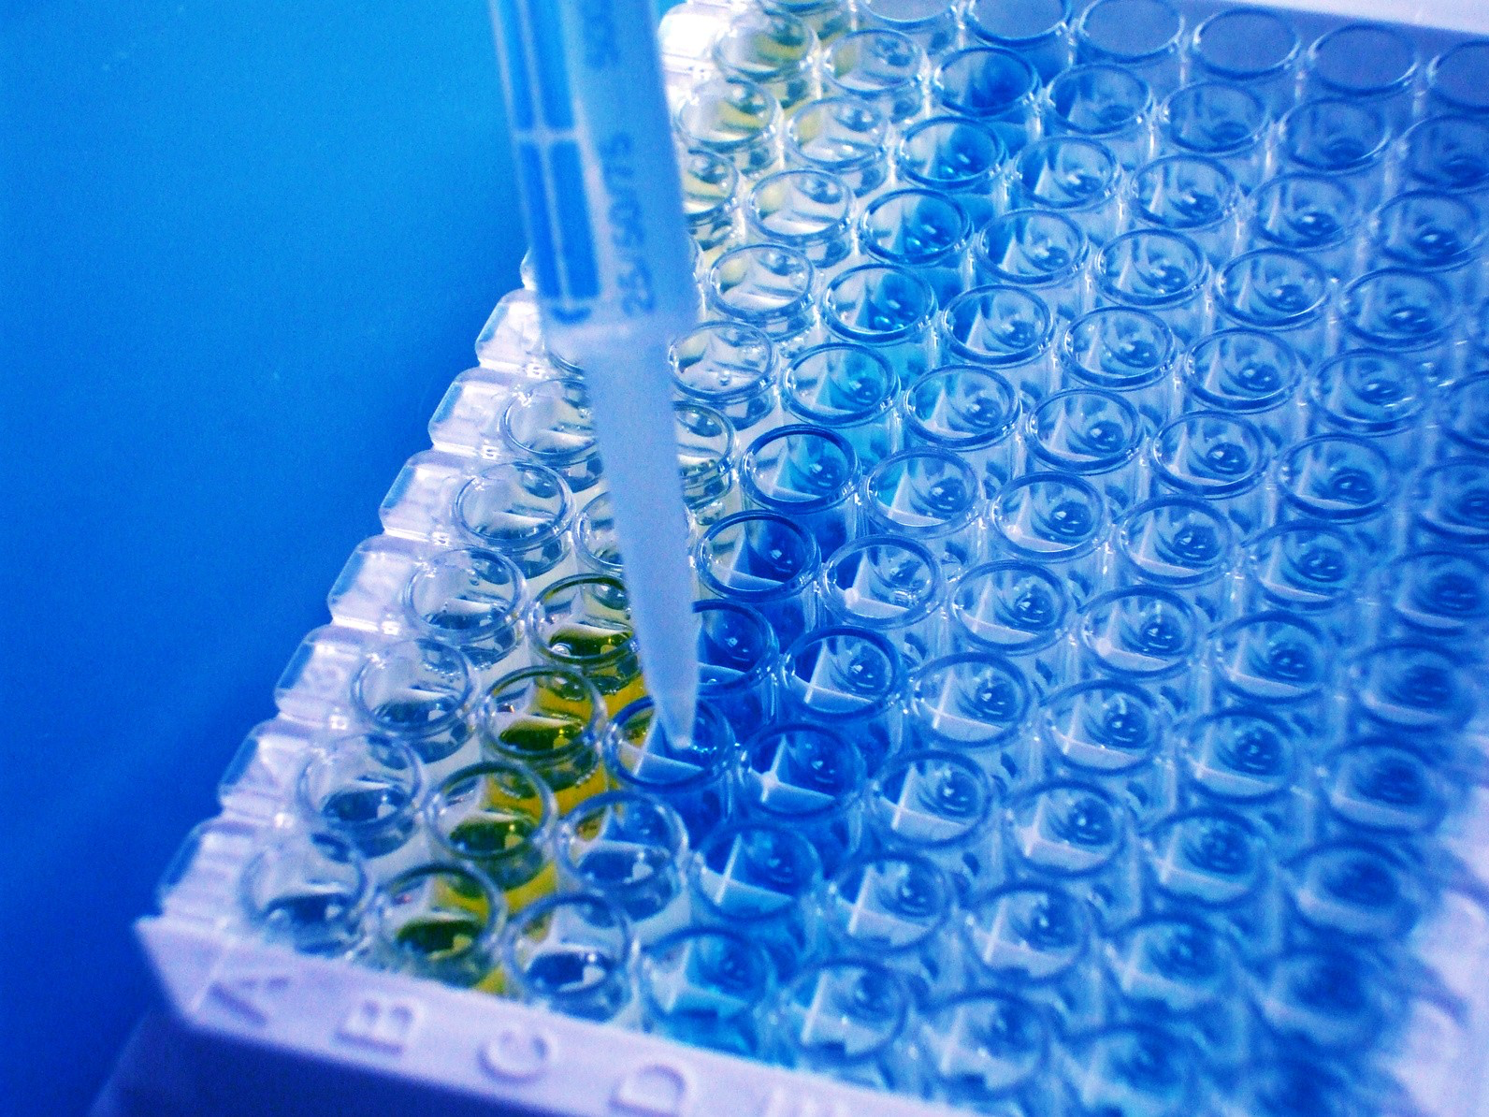
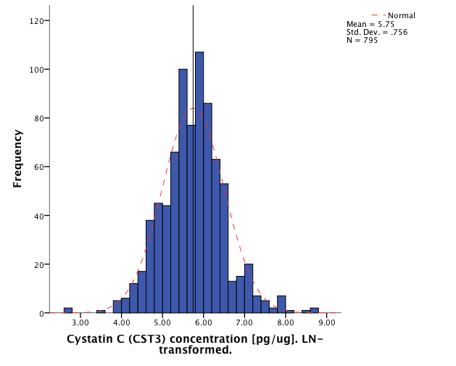
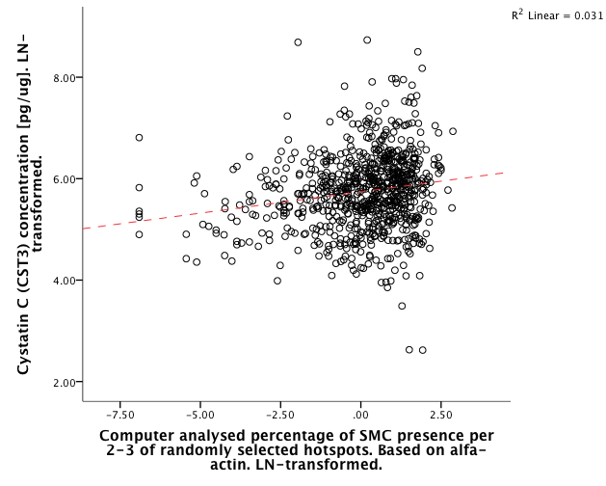
Luminex Cystatin C plaque levels
N = 795
Rho = 0.185 (R²=0.176), p = 1.10x10⁻⁷
Van der Laan et al. unpublished

Slide 39
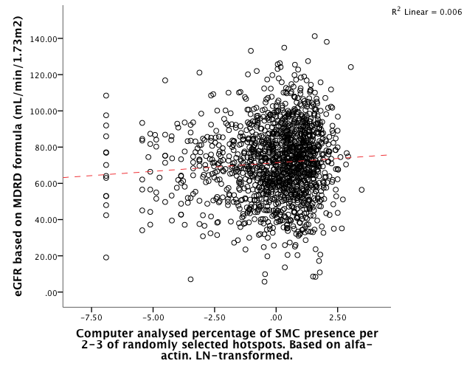
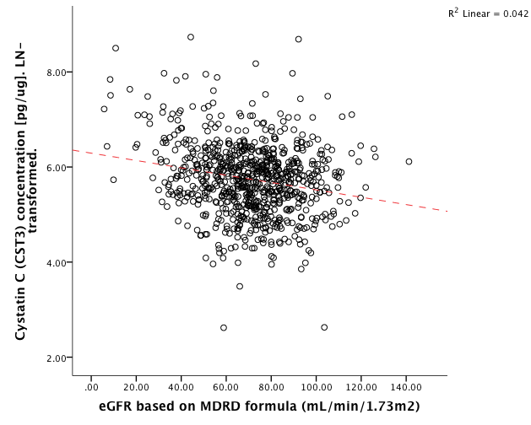
Associations with eGFR
SMC vs. eGFR: Rho = 0.084 (R² = 0.076), p = 1.35x10⁻³
eGFR vs. plaque CST3: Rho = -0.161 (R² = -0.206), p = 4.92x10⁻³
Van der Laan et al. unpublished

Slide 40
CystC-variant associated with SMC in plaques
In Athero-Express Genomics Study 1 (N=571) rs6114208 negatively correlated with SMCs in plaques, p=1.53x10⁻⁶
When analyzed with additional samples (Athero-Express Genomics Study 2, N=868), p = 0.0083, β = -0.161 (0.061), about 10.6% decrease in SMCs
Van der Laan et al. unpublished

Slide 41
Mendelian Randomization

Slide 42
Mendelian randomization
There is an large body of evidence from animal models, human specimens and epidemiological studies that Cystatin C is associated with CVD
It appears there is also a correlation between this variant, the amount of CystC, and the number of SMCs in plaques in the Athero-Express Biobank Study (N=1,439)
Is it causal or is it a bystander?
Use a genetic variant as a tool to investigate the causal role of Cystatin C in CVD
Van der Laan et al. unpublished

Slide 43
Alleles are randomly assigned: a “natural” treatment in a “natural” randomized trial
Katan, MB. Lancet 1986

Slide 44
The concept
For example: systolic blood pressure, or kidney function
Independent of confounding factors
Proportional to the G>R and R>H effects
Katan, MB. Lancet 1986

Slide 45
SNP selection
One GWAS on Cystatin C, rs1158167 in Framingham Heart Study
Three (meta-analyses of) GWAS on eGFR_{CystatinC}
rs911119, rs13038305
eGFR_{CystatinC} = 76.7 x (serum Cystatin C)^{-1.19}
Log linear relation between serum Cystatin C and eGFR
Proxy | Distance | r² | Chr | Position | Minor | Major | MAF | Variant | Gene
rs1158167 | 34,548 | 0.913 | 20 | 23,526,189 | G | A | 0.25 | downstream | n/a
rs17751897 | 20,023 | 0.955 | 20 | 23,540,714 | C | T | 0.242 | intergenic | n/a
rs12625716 | 5,892 | 0.955 | 20 | 23,554,845 | A | G | 0.242 | downstream | n/a
rs6048952 | 5,480 | 0.955 | 20 | 23,555,257 | G | A | 0.242 | downstream | n/a
rs13038305 | 2,475 | 1.00 | 20 | 23,558,262 | T | C | 0.233 | intronic | CST3
rs911119 | 0 | 1 | 20 | 23,560,737 | C | T | 0.233 | intronic | CST3
rs3827143 | 6,880 | 1 | 20 | 23,567,617 | G | A | 0.233 | upstream | n/a
rs6114208 | 8,997 | 1 | 20 | 23,569,734 | G | C | 0.233 | upstream | n/a
Van der Laan et al. unpublished

Slide 46
Studies included
Study | N_{total} | N_{SNP} | N_{CystC} | N_{CHD}
3C | 6,440 | 6,345 | 1,244 | 1,235
BWHHS | 3,413 | 3,402 | - | 308
CFS | 669 | 669 | 262 | -
EPIC-NL | 6,265 | 5,192 | - | 1,430
GOSH | 1,478 | 1,478 |  | 105
HRS | 5,585 | 5,585 | 5,585 | -
KORA | 4,856 | 1,867 | 4,676 | 341
PIVUS | 1,016 | 949 | 1,004 | 175
PREVEND | 3,296 | 3,296 | 3,296 | 191
Rotterdam | 4,730 | 5,974 | 3,906 | 1,934
SHIP | 3,224 | 3,224 | 3,212 | 19
Tromsø | 6,175 |  | 6,175 | 1,263
TWINGENE | 8,313 | 6,353 | 6,768 | 725
ULSAM | 1,221 | 1,107 | 1,193 | 285
WHI | 3,074 | 3,074 | 3,074
Whitehall II | 4,961 | 5,011 |  | 254
Overall | 55,467 | 50,542 | 31,146 | 7,002
CARDIoGRAM | 86,959 |  |  | 22,233
METASTROKE | 74,393 |  |  | 12,389
CHARGe HF | 20,926 |  |  | 2,526
There are many more cohorts, but…
…we discovered that a similar effort is underway in the US…
…but it’s focused on the causal relation with CKD
So ours includes mainly European cohorts
Maybe we’ll be able to collaborate in the future?
Van der Laan et al. unpublished

Slide 47
Cystatin C and risk factors #1
Trait | N | N studies | BETA | P | I² | P_{het}
Sex | 19,589 | 4 | 0.093 (0.084-0.101) | 5.2x10⁻¹⁰⁴ | 75.21 | 0.007
Age | 20,782 | 5 | 0.011 (0.011-0.012) | <5.0x10⁻³⁰⁰ | 99.27 | 6.59x10⁻¹¹⁸
HDL | 20,731 | 5 | -0.154 (-0.163--0.144) | 1.21x10⁻²⁰⁷ | 35.52 | 0.184
Systolic BP | 20,154 | 5 | 0.003 (0.003-0.003) | 4.07x10⁻¹⁴⁹ | 96.12 | 2.29x10⁻²¹
BMI | 20,194 | 5 | 0.014 (0.013-0.015) | 1.6x10⁻¹⁵⁸ | 88.72 | 3.71x10⁻⁷
Smoking status | 20,770 | 5 | 0.015 (0.009-0.021) | 1.626x10⁻⁷ | 88.56 | 4.69x10⁻⁷
CKDEPI | 20,720 | 5 | -0.011 (-0.011--0.011) | <5.0x10⁻³⁰⁰ | 98.92 | 1.41x10⁻⁷⁸
Van der Laan et al. unpublished

Slide 48
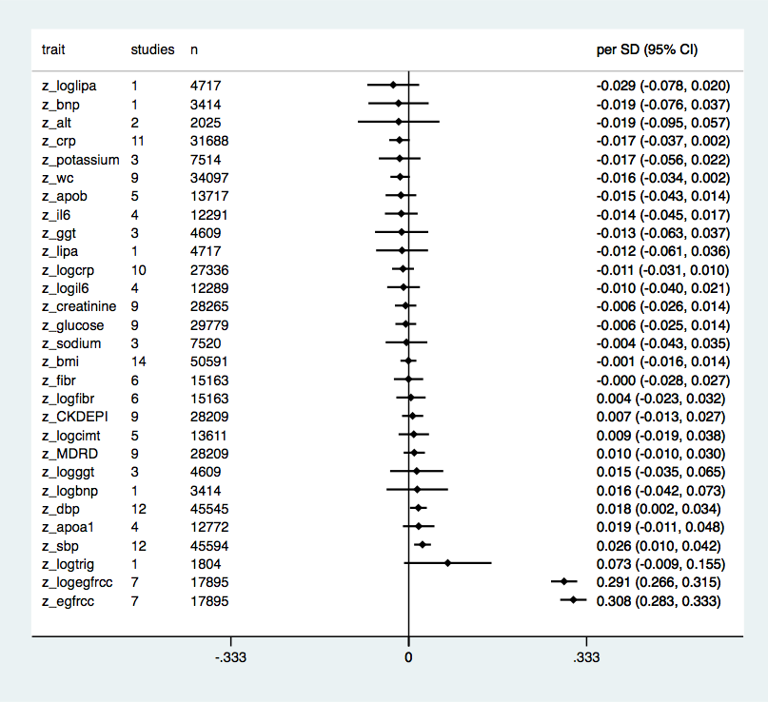
Cystatin C and risk factors #2
SBP might be associated with CystC levels
Strong relation of CystC with eGFR
Van der Laan et al. unpublished

Slide 49
Observational analysis
“univariate” model: age + sex
multivariate model: age + sex + HDL + systolic blood pressure + BMI + smoking status + CKDEPI
Van der Laan et al. unpublished

Slide 50
Are frequencies comparable?
Van der Laan et al. unpublished

Slide 51
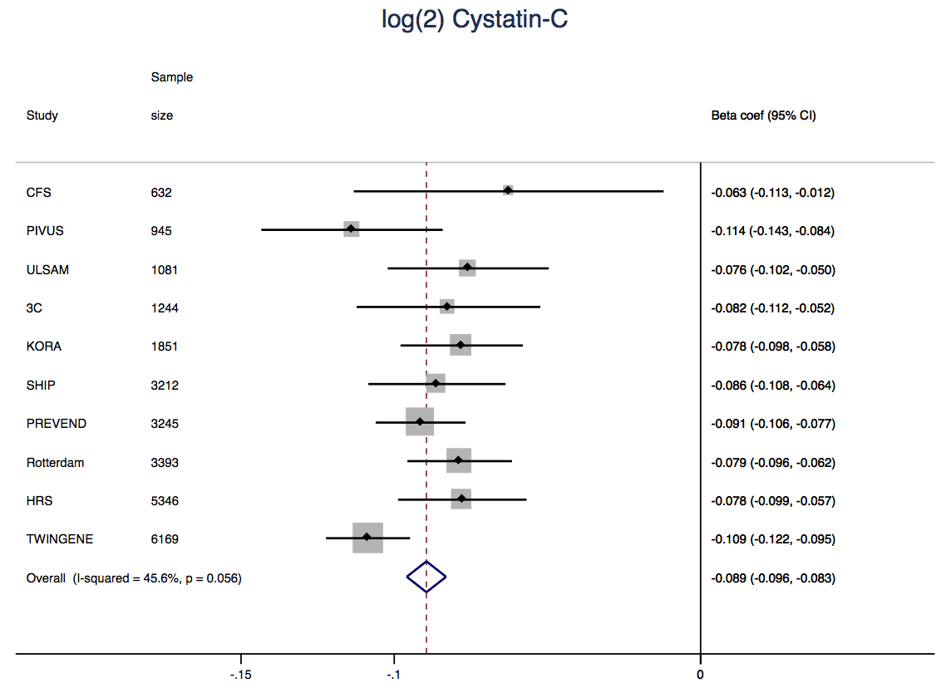
SNP vs. Cystatin C
Per minor allele there is ≈ 6% decrease in CystC [mg/L]
β = -0.089 [-0.096-0.083], p = 2.10x10-164, N = 24,642
This explains ≈2.5% of the phenotypic variation
Van der Laan et al. unpublished

Slide 52
SNP vs. CVD
The SNP affecting CystC levels is not associated with CHD
OR = 1.01 [0.99-1.03], p = 0.41, N>49,165 cases
Van der Laan et al. unpublished

Slide 53
Conclusions
Cystatin C downregulated in atherosclerotic plaques
There is a correlation between the number of SMCs, eGFR and plaque-CystC
Variants in CystC are associated with SMCs in plaques
Strong epidemiological evidence for a role of CystC in CVD
Variants in CystC associated with serum CystC levels
Variants in CystC are not associated with CVD

Slide 54
HDL protective of MI?
Various variants known to influence HDL levels
HDL levels are associated with lower risk of MI (or CAD)
Some also associated with the risk of MI (or CAD)
Is a lower HDL level causal to a lower risk for MI?

Slide 55
The answer in three steps… #1
Various variants associated with HDL levels

Slide 56
The answer in three steps… #2
LIPG variant associates with HDL levels

Slide 57
The answer in three steps… #3
No association with MI…

Slide 58




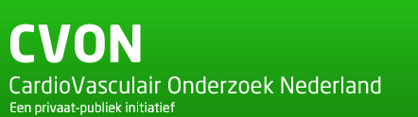





Cardiovascular Genetic Research
Experimental Cardiology Laboratory
Prof. Dr. G. Pasterkamp
Dr. Hester M. den Ruijter
Dr. Jessica van Setten
Medical Genetics
Prof. Dr. P.I.W. de Bakker
Drs. Sara L. Pulit
Cardiology
Dr. F.W. Asselbergs
Magdalena Harakalova
Research topics
Biomarker Discovery & Validation
Athero-Express | CTMM: Circulating Cells
Sex differences in Cardiovascular Disease
Athero-Express | CTMM | UCORBIO
Ischemic stroke
GWAS
Cardiovascular Genomics
Next-Generation Sequencing | Pharmacogenomics
S.W. van der Laan – s.w.vanderlaan-2@umcutrecht.nl

